Slide 1
Fitting Precipitation Data with Gamma Distribution &
Following Chi-Square Test
- Possible Gaps Between Theories and Practices
Shangyong Shi
MET 6308 2019.12.5

Slide 2

Part 0
References

Slide 3
Part 0 References
Theory
Wilks, Daniel S. Series: International Geophysics Series, v. 91. Edition: 2nd ed. Amsterdam : Academic Press. 2006. eBook
Practice
Becker, E. J., Berbery, E. H., & Higgins, R. W. (2009). Understanding the characteristics of daily precipitation over the United States using the north American regional reanalysis. Journal of Climate, 22(23), 6268–6286. https://doi.org/10.1175/2009JCLI2838.1

Slide 4
Part 1 - Theories
Backgrounds about Histogram, Gamma Distribution and Chi-Square Test

Slide 5
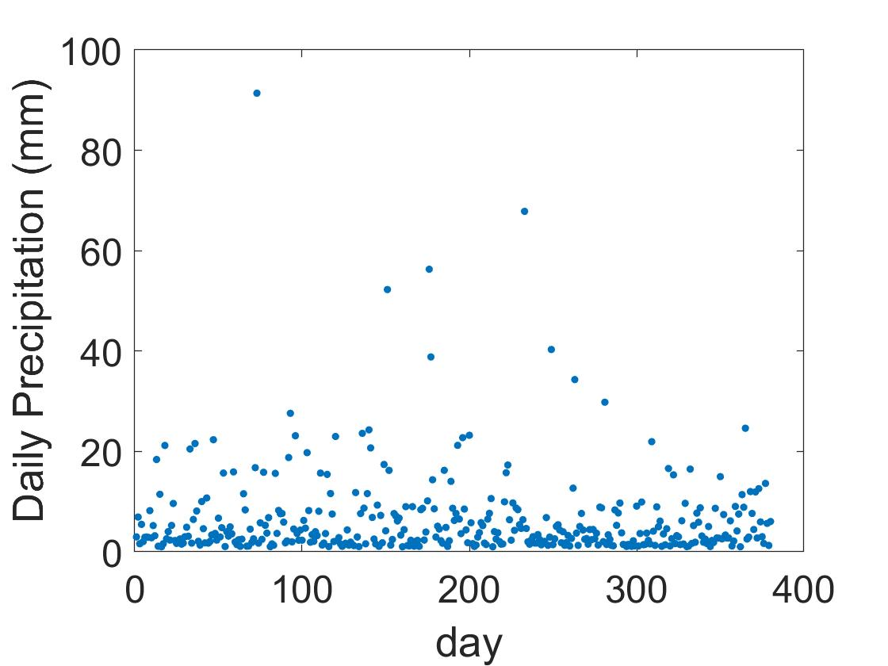
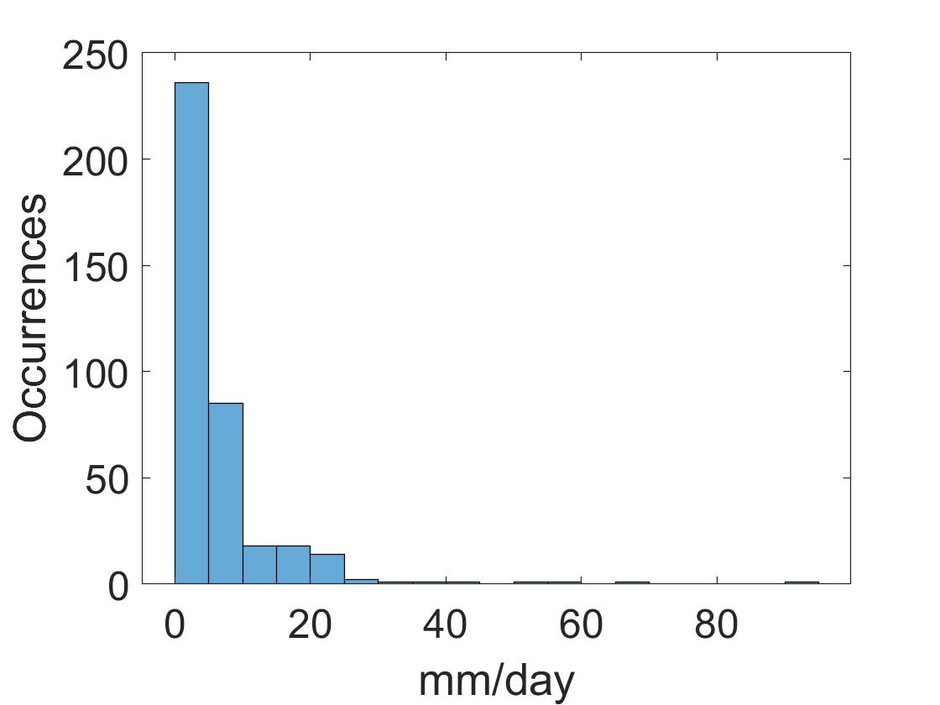
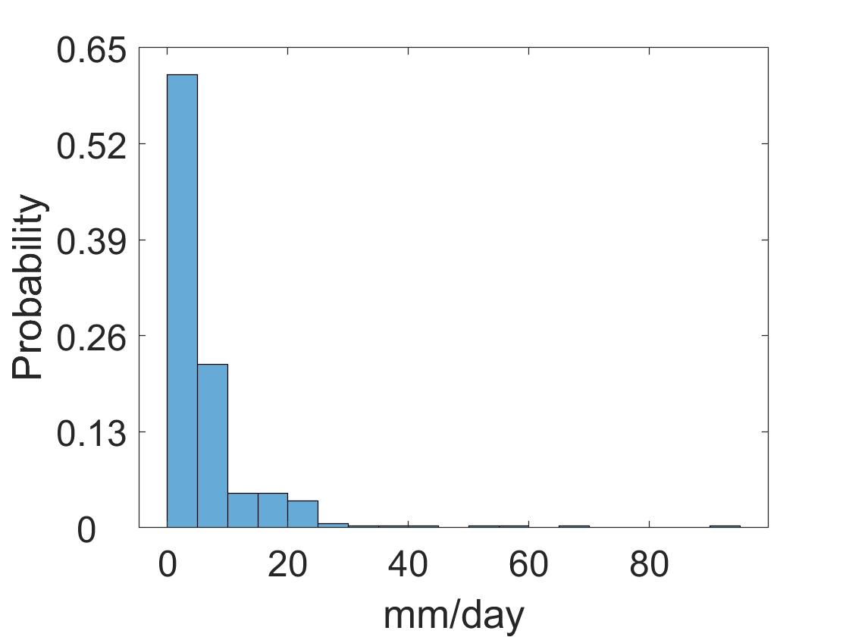
Histogram
Arranged into bins, number of values falling into that interval is counted.
Divided by total number of observations, we get probabilities for each bin
One Grid, 27-year DJF Daily Precipitation
It is the areas of the histogram bars (rather than their heights) that are proportional to probabilities.
This point becomes important if the histogram bins are chosen to have unequal widths, or when a parametric probability function is to be superimposed on the histogram.

Slide 6
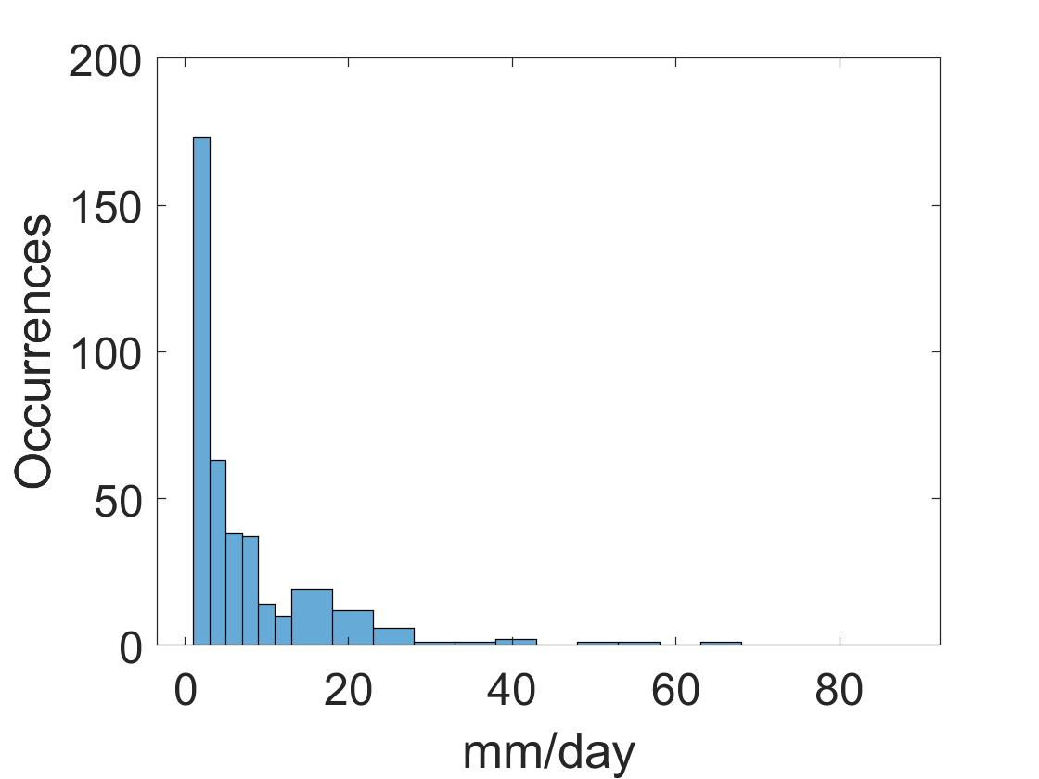
Histogram
Unequal bins
Equal bins
edges = [1:2:11,13:5:max(x)]
Rescale the histogram so the total area = 1
Frequency Density
=Frequency/binwidth
=occurrence in each bin/total obs/binwidth
It is the areas of the histogram bars (rather than their heights) that are proportional to probabilities.
This point becomes important if the histogram bins are chosen to have unequal widths, or when a parametric probability function is to be superimposed on the histogram.

Slide 7
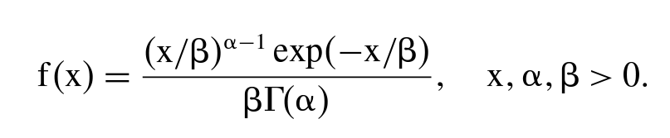
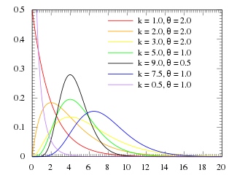
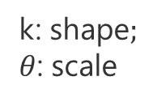
Gamma Distribution
The gamma distribution is defined by the probability density function (PDF):
$α:$the shape parameter; $β:$the scale parameter. The $Γ(α)$ quantity is the gamma function
Gamma distribution
k: shape$;$
$θ$: scale
Notes:
There are a variety of continuous distributions that are bounded on the left by zero and positively skewed. One common choice, used especially often for representing precipitation data, is the gamma distribution.

Slide 8
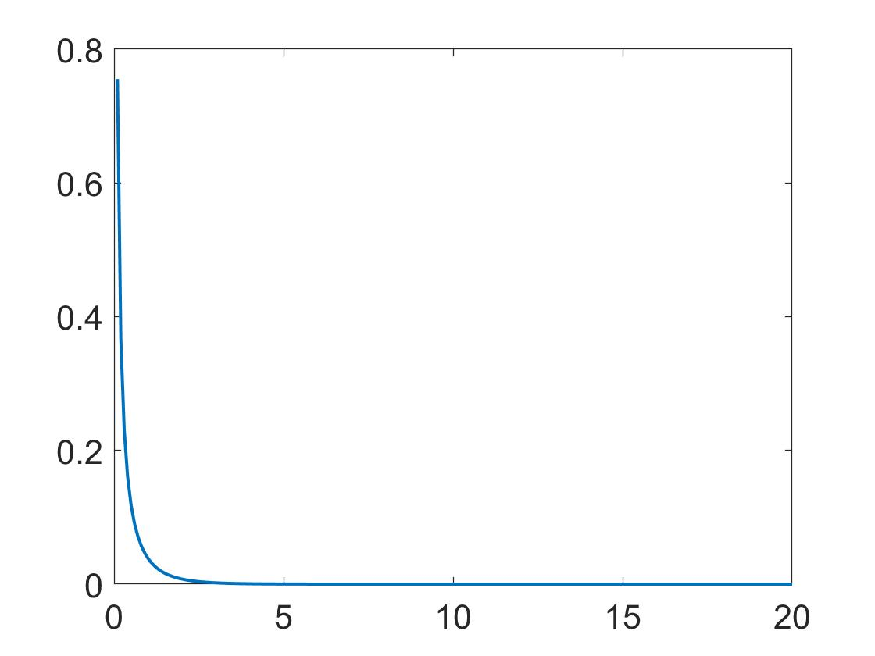
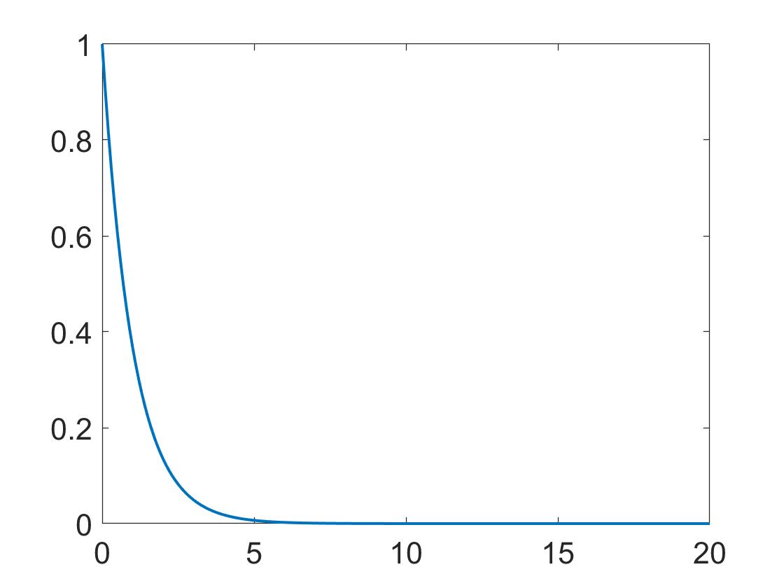
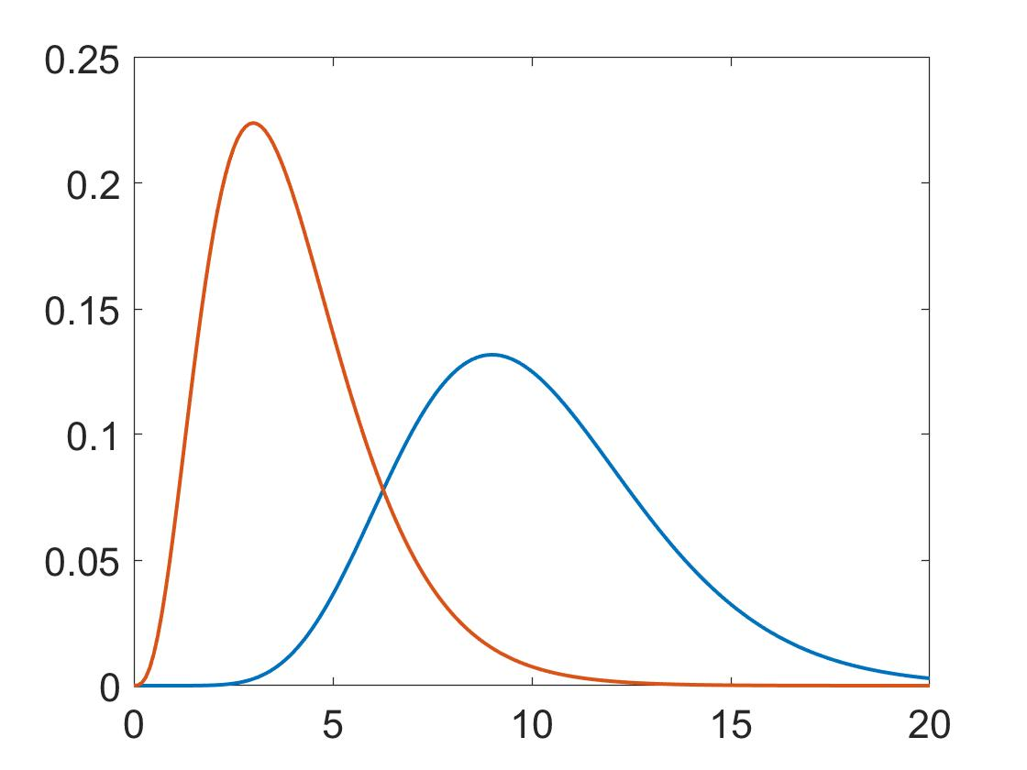
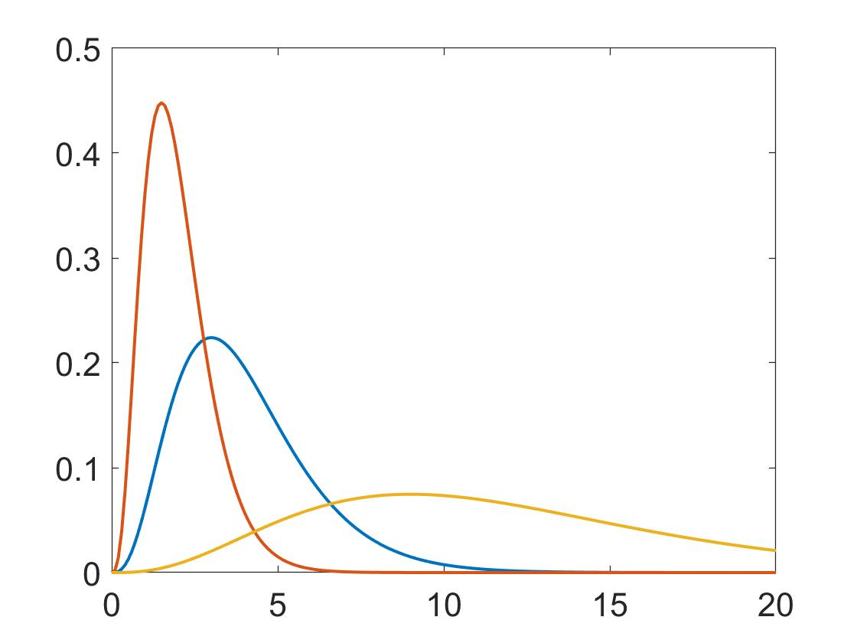
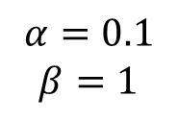
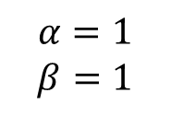
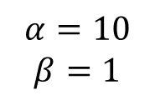
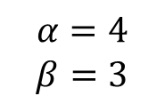

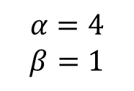
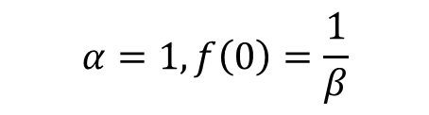
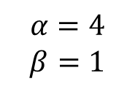

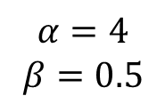
Gamma Distribution
Shape
$$α<1, \lim_{x→0}{f\left(x\right)=0}$$
$$α=1, f\left(0\right)=\frac{1}{β}$$
$$α>1$$
$$α=4$$
$$β=1$$
$$α=0.1$$
$$β=1$$
$$α=1$$
$$β=1$$
$$α=10$$
$$β=1$$
$$α=4$$
$$β=0.5$$
Scale
$$α=4$$
$$β=1$$
$$α=4$$
$$β=3$$
Notes:
The role of the scale parameter, , effectively is to stretch or squeeze (i.e., to scale) the gamma density function to the right or left, depending on the overall magnitudes of the data values represented. As the distribution is stretched to the right by larger values of , its height must drop

Slide 9


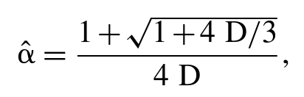
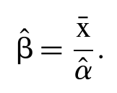
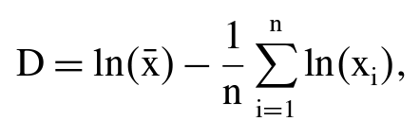
Estimate Parameters from Data
Estimate by Method of Moments - not bad for large values of the shape parameter
Mean of the gamma distribution: $αβ$, variance: $αβ^{2}$
Estimate by Method of Maximum Likelihood – iterative, much better
(Thom,1958)
(Greenwood and Durand 1960)
Notes:
The versatility in shape of the gamma distribution makes it an attractive candidate for representing precipitation data, and it is often used for this purpose. However, it is more difficult to work with than the Gaussian distribution, because obtaining good parameter estimates from particular batches of data is not as straightforward.

Slide 10
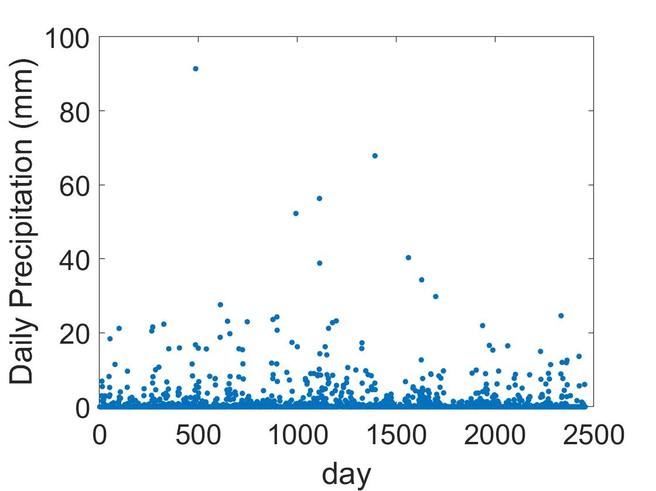
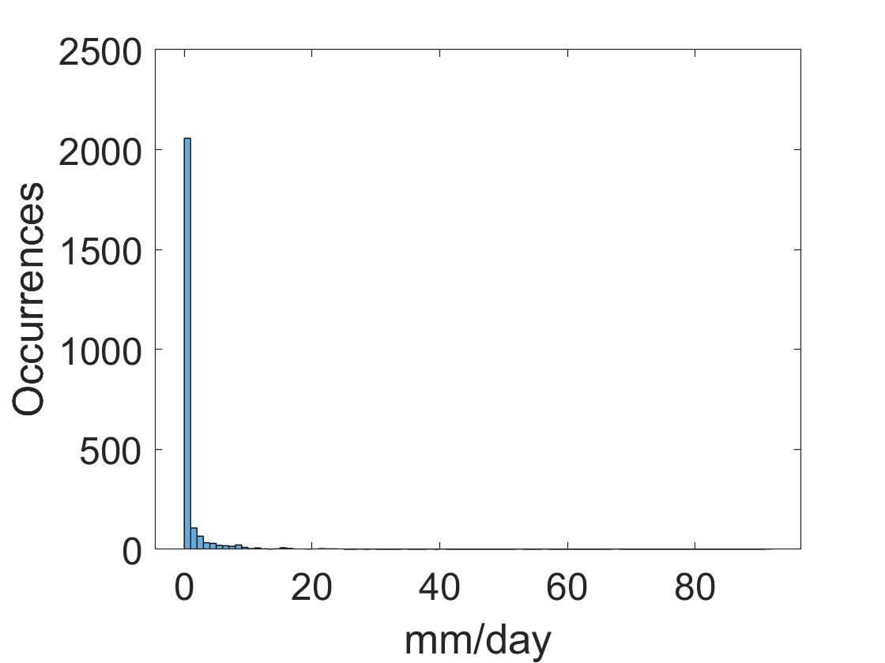
Example of Fitting Gamma Distribution
One Grid, 27-year DJF Daily Precipitation
One Grid, 27-year DJF Wet Day Precipitation
Get rid of 0
Set wet day threshold:
1 mm/day

Slide 11
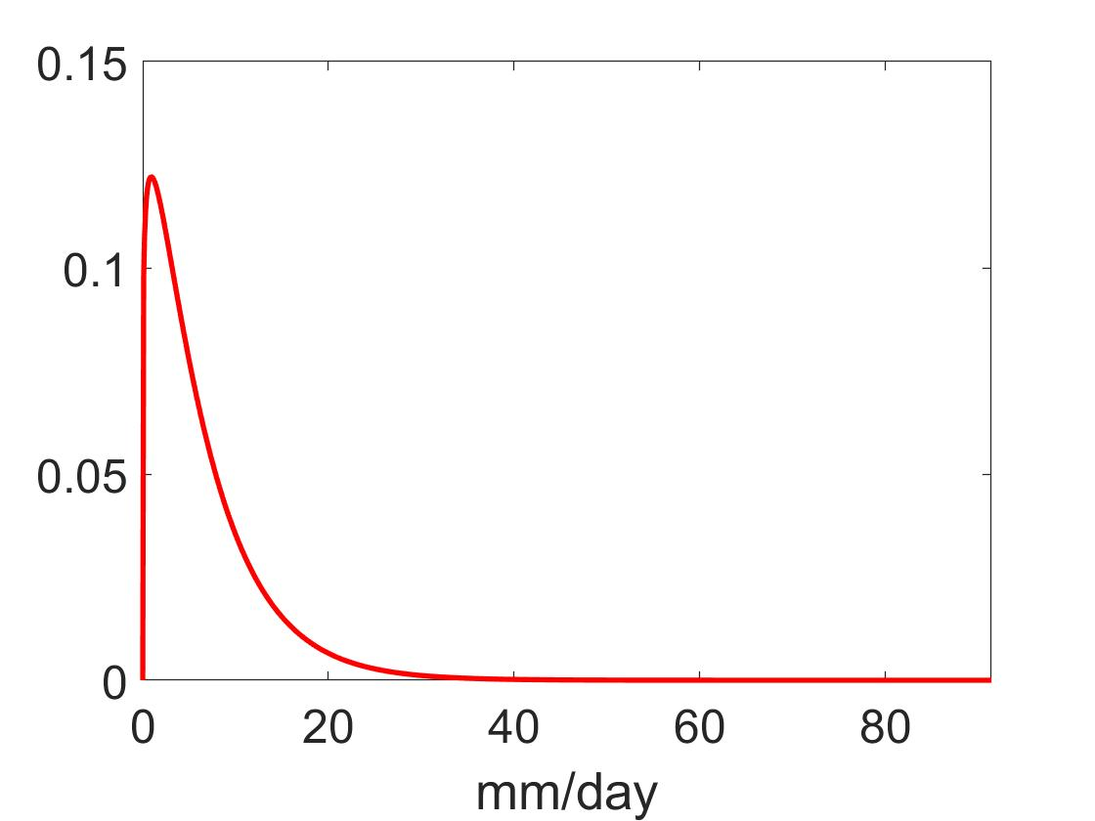
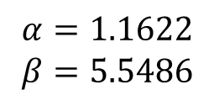
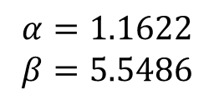
Example of Fitting Gamma Distribution
One Grid, 27-year DJF Wet Day Precipitation
Estimated Gamma Distribution PDF
$$α=1.1622$$
$$β=5.5486$$
How to superimpose fitted PDF onto a histogram?
$$α=1.1622$$
$$β=5.5486$$

Slide 12
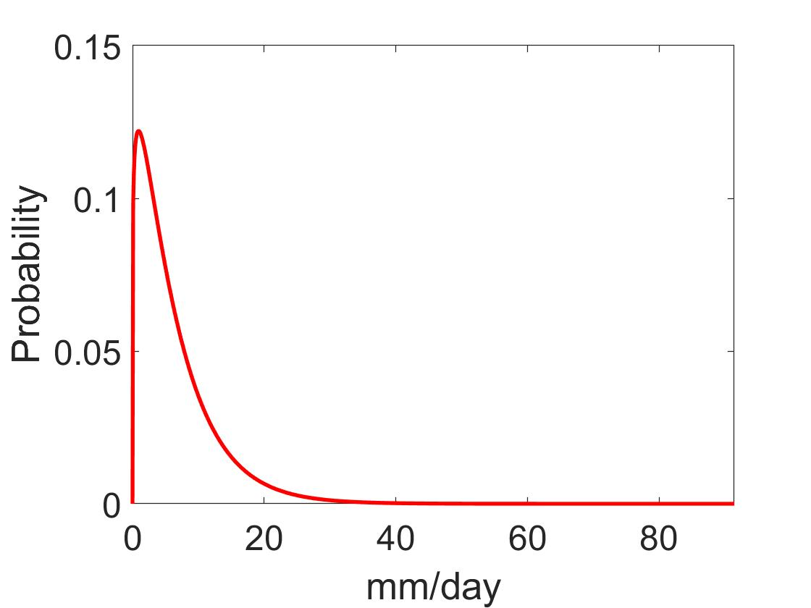

Superposition of a Fitted Parametric Distribution and Data Histogram
Key: the integral of PDF = the area of histogram bars (Probability Density)
Frequency = number of occurrence in one bin/total number of observations
Rescale the PDF (multiply number of days)
Rescale the histogram (so that total area is 1)
What if we use wet day frequency? – the integral of PDF will not be 1, but
In this case, the pdf should multiply a factor of (number of wet days)
$$\frac{number of wet days}{number of days}$$

Slide 13
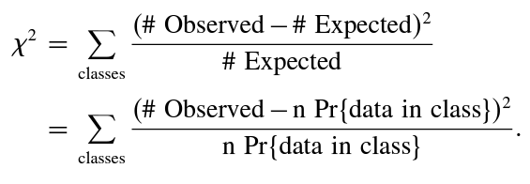
Goodness of Fit Test – Chi-Square Test
Null hypothesis: the data is drawn from the hypothesized distribution
If the fitted distribution is very close to the data, Chi-Square will be small
If the fit is not good, Chi-Square will be large
What’s the threshold?
Notes:
In each class, the number (#) of data values expected to occur, according to the fitted distribution, is simply the probability of occurrence in that class multiplied by the sample size, n . The number of expected occurrences need not be an integer value. If the fitted distribution is very close to the data, the expected and observed counts will be very close for each class; and the squared differences in the numerator of Equation 5.14 will all be very small, yielding a small 2 . If the fit is not good, at least a few of the classes exhibit large discrepancies.

Slide 14
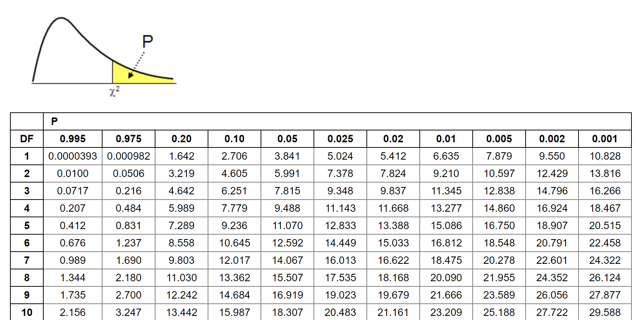
Values of Chi-Square Test – Degree of Freedom
In textbook:
degrees of freedom: (#of classes–#of parameters fit–1)
Notes:
Under the null hypothesis that the data were drawn from the fitted distribution, the sampling distribution for the test statistic is the 2 distribution with parameter = (#of classe s–#of parameters fit–1) degrees of freedom. The test will be one-sided, because the test statistic is confined to positive values by the squaring process in the numerator of Equation 5.14, and small values of the test statistic support H 0

Slide 15
Some Questions You Might Have When You Practice…
For original data processing,
Fitting daily data? Monthly data?
What threshold should we use to define “wet day”?
How will the selection of threshold influence our result, and how to fix this?
Is it suitable to use gamma distribution?
For Chi-Square Test,
How many bins we should we define?
What degree of freedom we should use as a standard to determine the test?

Slide 16
Part 2 - Practices
Discussions About Becker et al
- So Many Problems?

Slide 17
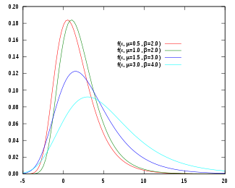
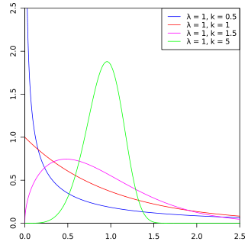
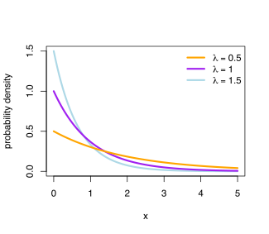
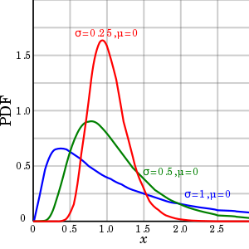
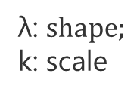

Statistical Distributions to Approximate Daily Precipitation Totals…
Gamma distribution
[Groisman et al., 1999]
Gumbel distribution
[Koutsoyiannis 2004]
Weibull distribution
λ: $shape;$
$\text{k}$: scale
μ: $location;$
$\text{β}$: scale
k: shape$;$
$θ$: scale
mixed exponential
[Woolhiser and Roldan, 1982]
log-normal
[Biondini, 1976]

Slide 18
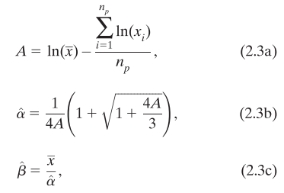
Becker’s Method
The focus is on the relative contributions of heavy-to-extreme daily events and light-to- moderate events to the seasonal total. Thus, the gamma distribution, with the sensitivity of its shape and scale parameters to shifts in the underlying histogram, is a helpful tool.
Data: CPC daily, 0.25*0.25, 1979-2005 (27years)
Precipitation: days with >1.0mm/day
Gamma distribution estimation:
maximum likelihood estimators (MLE)
Goodness of fit test: Chi-square
0.05 level

Slide 19
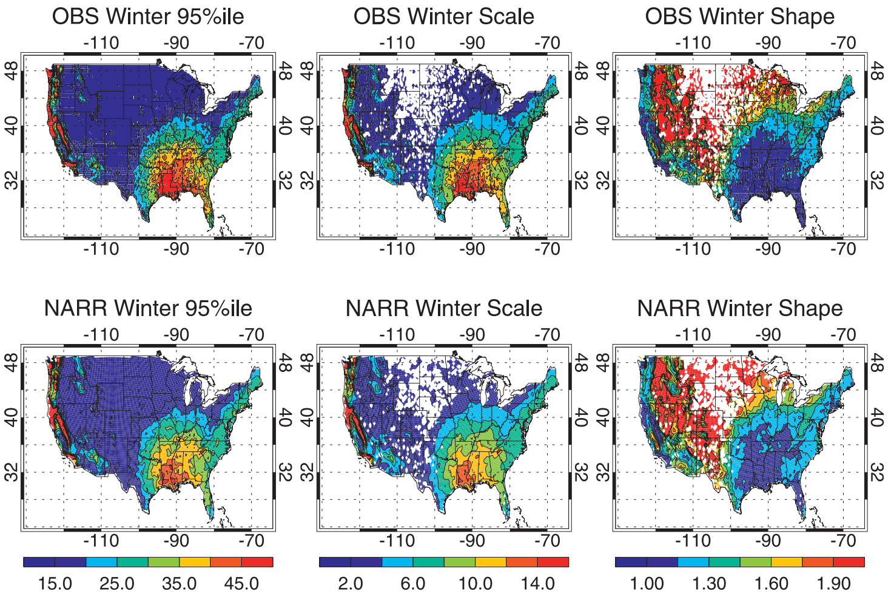
Becker et al Fig. 3

Slide 20
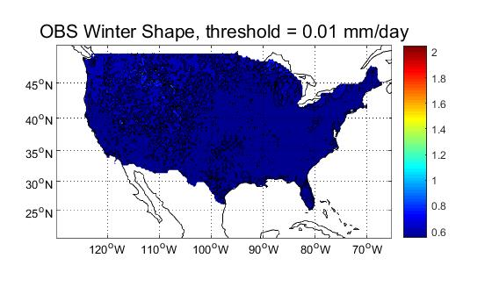
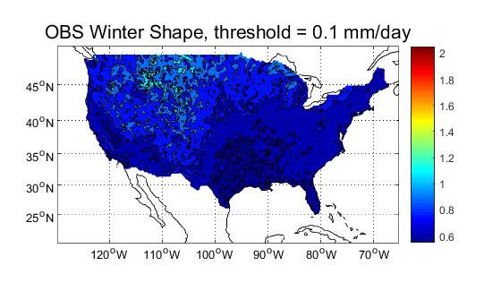
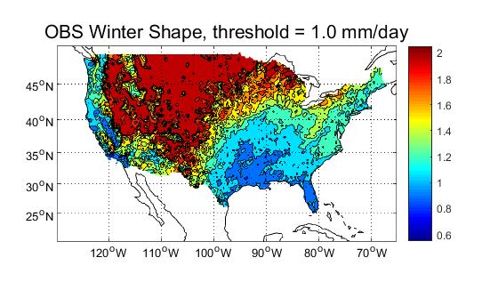
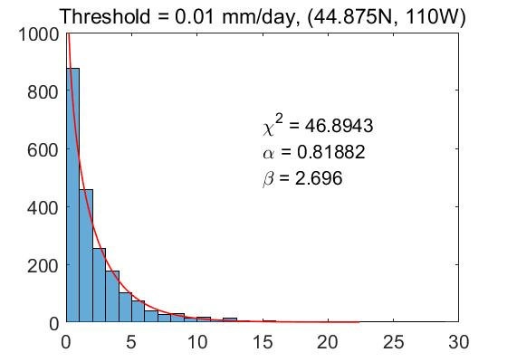
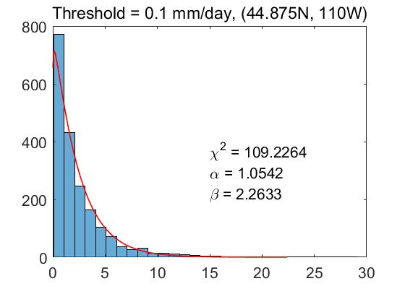
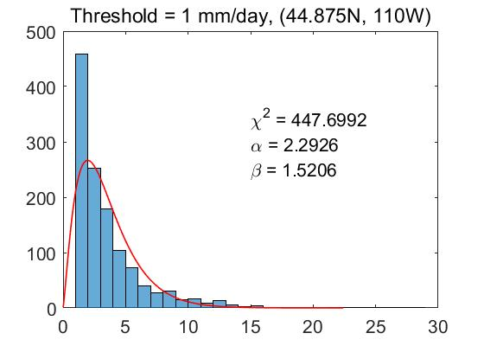
Selection of Threshold

Slide 21
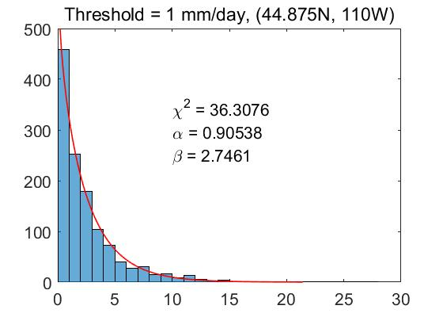
Fit to shifted series
Fit to x>1
Fit to x'=x-1

Slide 22
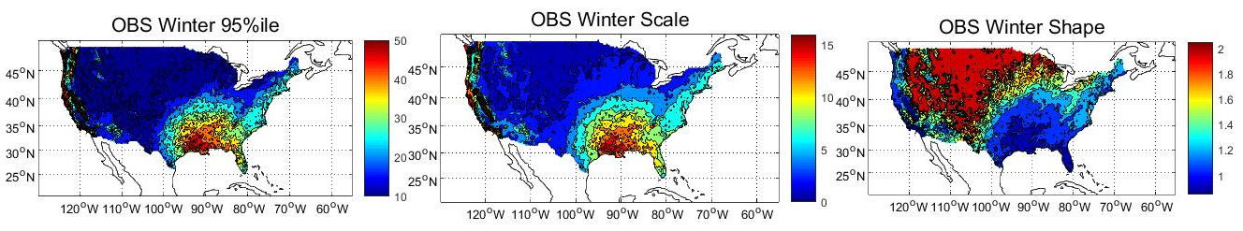
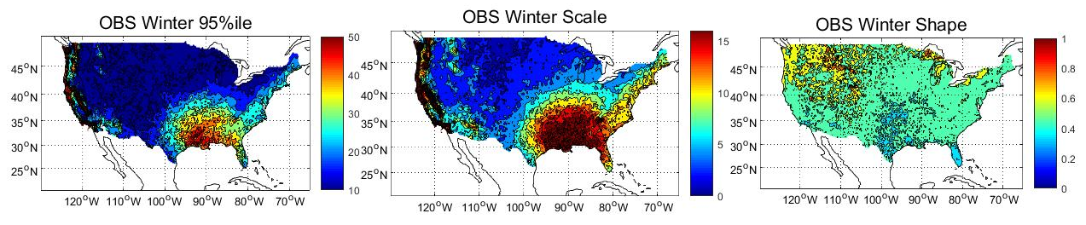
My Reproduction (No Goodness-of-fit test)
Fit to shifted series (x-1) (No Goodness-of-fit test)

Slide 23
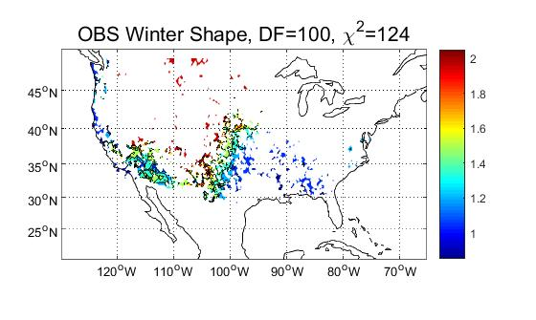
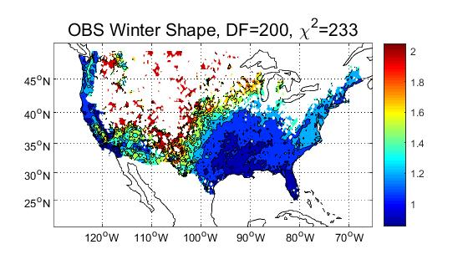
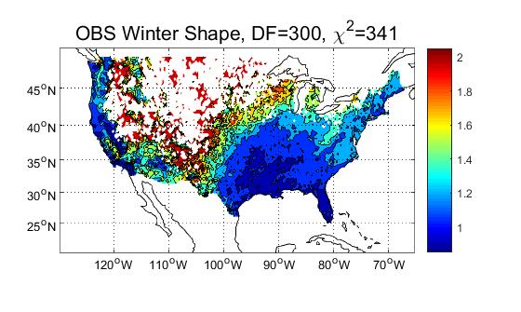

Selection of Degree of Freedom
Chi-Square Test with Different Degree of Freedom

Slide 24

Tails
Why will chi-square value so large?

Slide 25



PDF for one grid in peninsular Florida, JJA 39yr
uniform bins 1mm
chi2: 4646
inuniform bins
chi2: 63.1
Probability of one bin:
integral of PDF in this bin
details:

Slide 26
Conclusions
For original data processing,
Daily? Monthly?
Fitting any kind of data with gamma distribution needs to filter out non-precipitation days. However, the threshold matters if we don’t shift the histogram.
How will the selection of threshold influence our result, and how to fix this?
We should fit the distribution to (data – threshold)
Is it suitable to use gamma distribution?
It depends! If tail is not exponential decay, but heavy tail…
For Chi-Square Test,
What degree of freedom we should use as a standard to determine the test?
Data’s degree of freedom

Slide 27
PRESENTED BY Shangyong Shi
THANKS
Shangyong Shi
MET 6308 2019.12.5

